Slide 1
BBM-412 term Project
Turtle maze game wıth opengl

Slide 2
the game
The goal of the game is to find the way out from the maze and to collect most points by collecting cabbages distributed randomly inside the maze.
To achieve that you have to look at the maze from birdseye view. However you can’t move your turtle in this perpective, you have to use close 3rd person view.

Slide 3
controls
We added controls to the game both with keyboard and control panel.
To select game mode(1 or 2 player) when game loads press «1» or «2».
To move Player1 use «WASD», to move Player2 use «Arrow Keys».
To change perspective press «G» for Player1 and «K» for Player2.
To activate Free Camera Mode press «Y».
To change the shading to Black-White press «T».
To open the UI controller menu press «U».

Slide 4
Splıt screen
We achieved split screen by «glViewport()» function. It is a method which specifies the draw area on a window.
Also we defined two cameras which basically is two different view maticies.
Each object in game drawn twice according to these matricies.

Slide 5
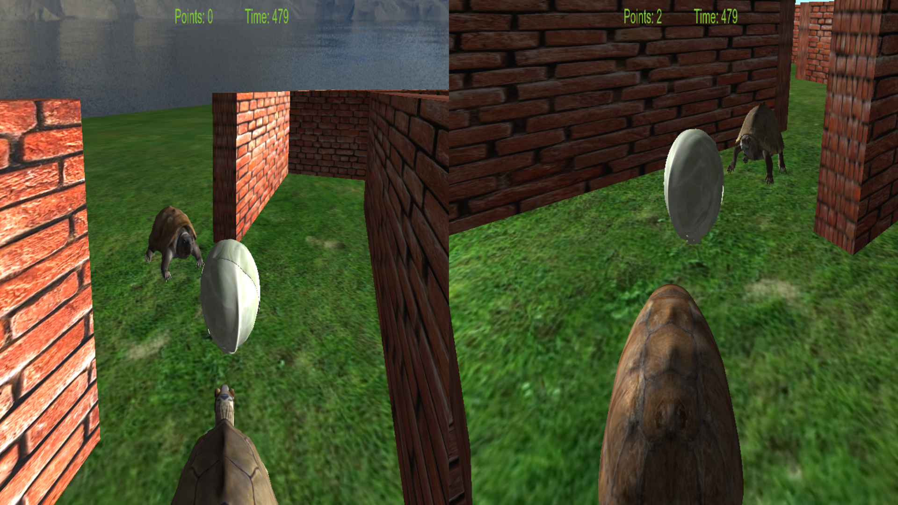

Slide 6
Followıng Camera and bırdseye vıew
We achieved following Camera by giving an offset relative to the Turtle models which we passed with a pointer during the initialization of the Camera class.
In the same fashion we achieved birdseye view by giving an offset to Camera relative to the Turtle models and slowly move camera to that offset which resulted in an animation-like scene.

Slide 7
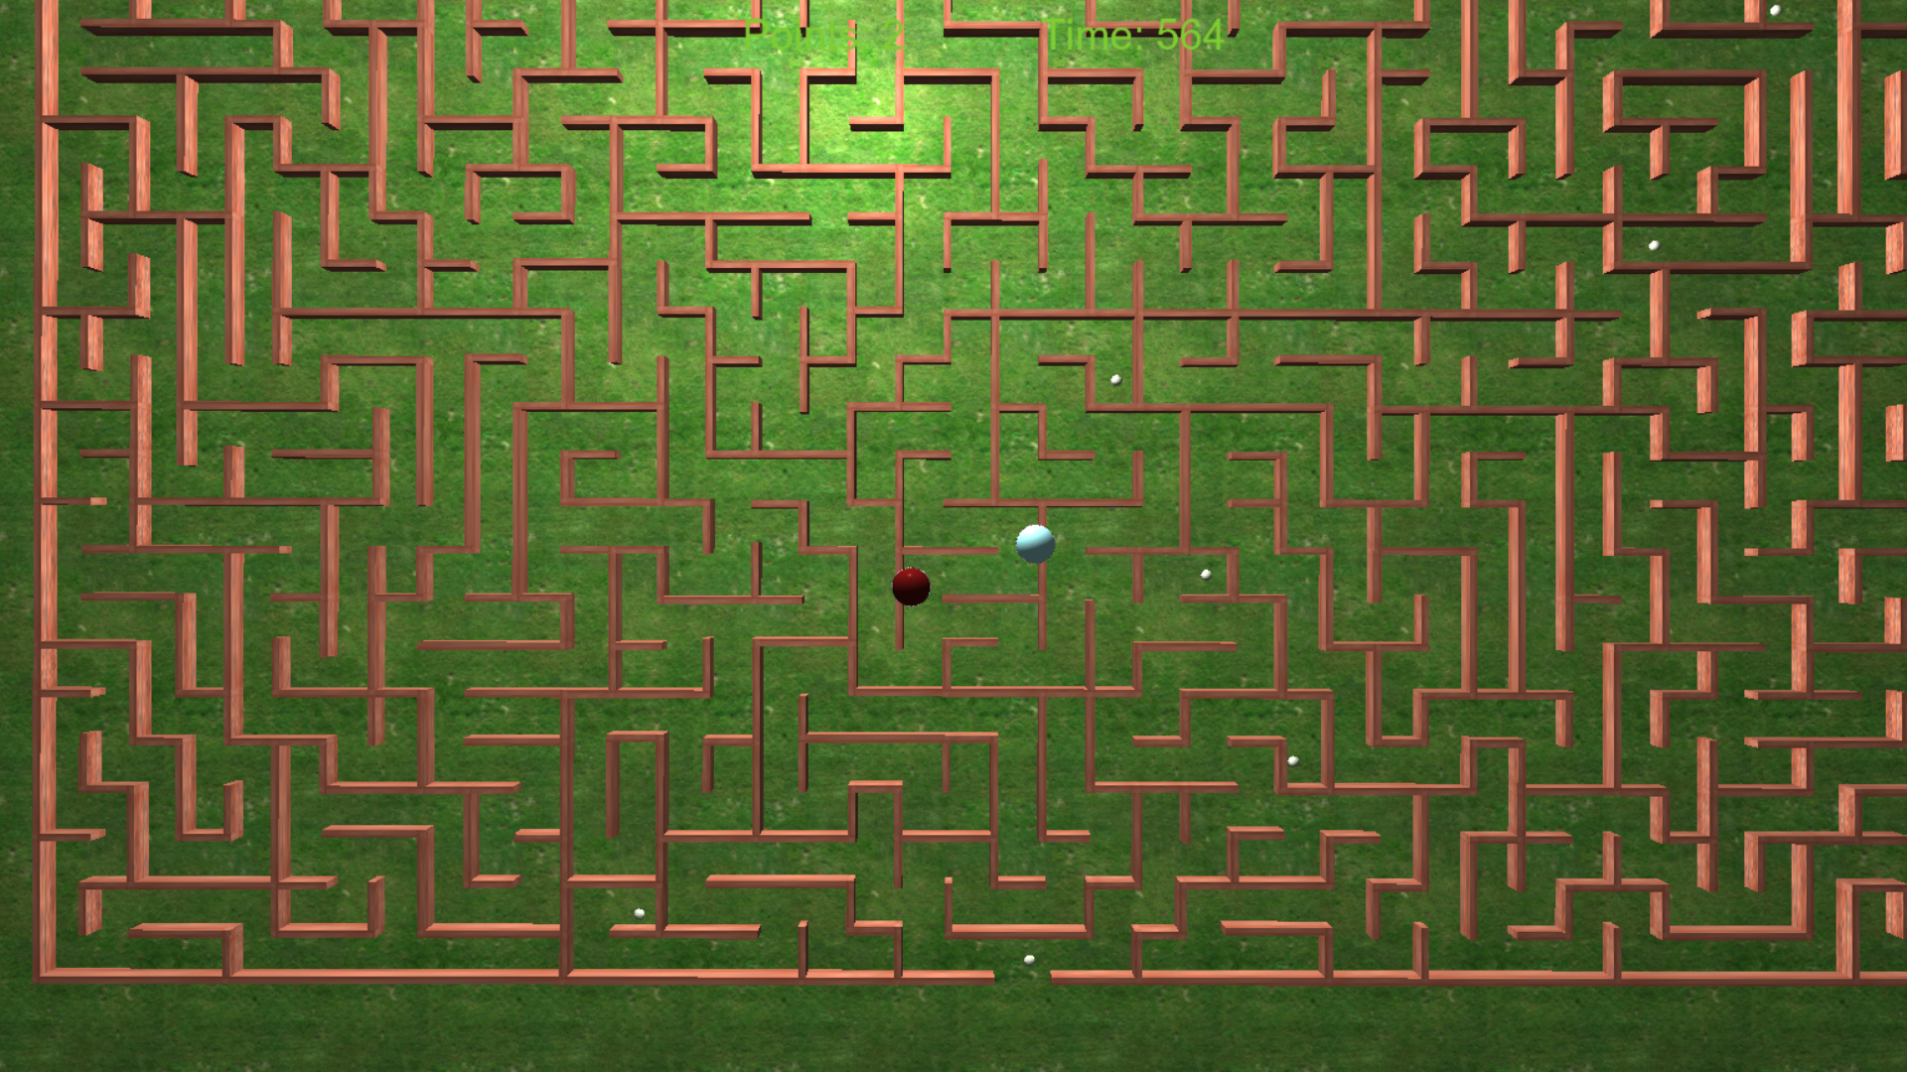

Slide 8
Sound and walk anımatıon
For walk animation we translated turtles up and down by some amount each frame.
In this translation function when turtle reaches the lowes point we played the sound we have loaded before.
We used irrKlang which is a free closed source sound library.

Slide 9
Control panel And free camera mode
We built control panel with GLUI which is a free user interface library.
It allows us to control two turtle objects, one cabbage object and the position, direction and the power of the light source.
Free Camera mode allows us to move the camera anywhere in the game world without any restrictions.

Slide 10
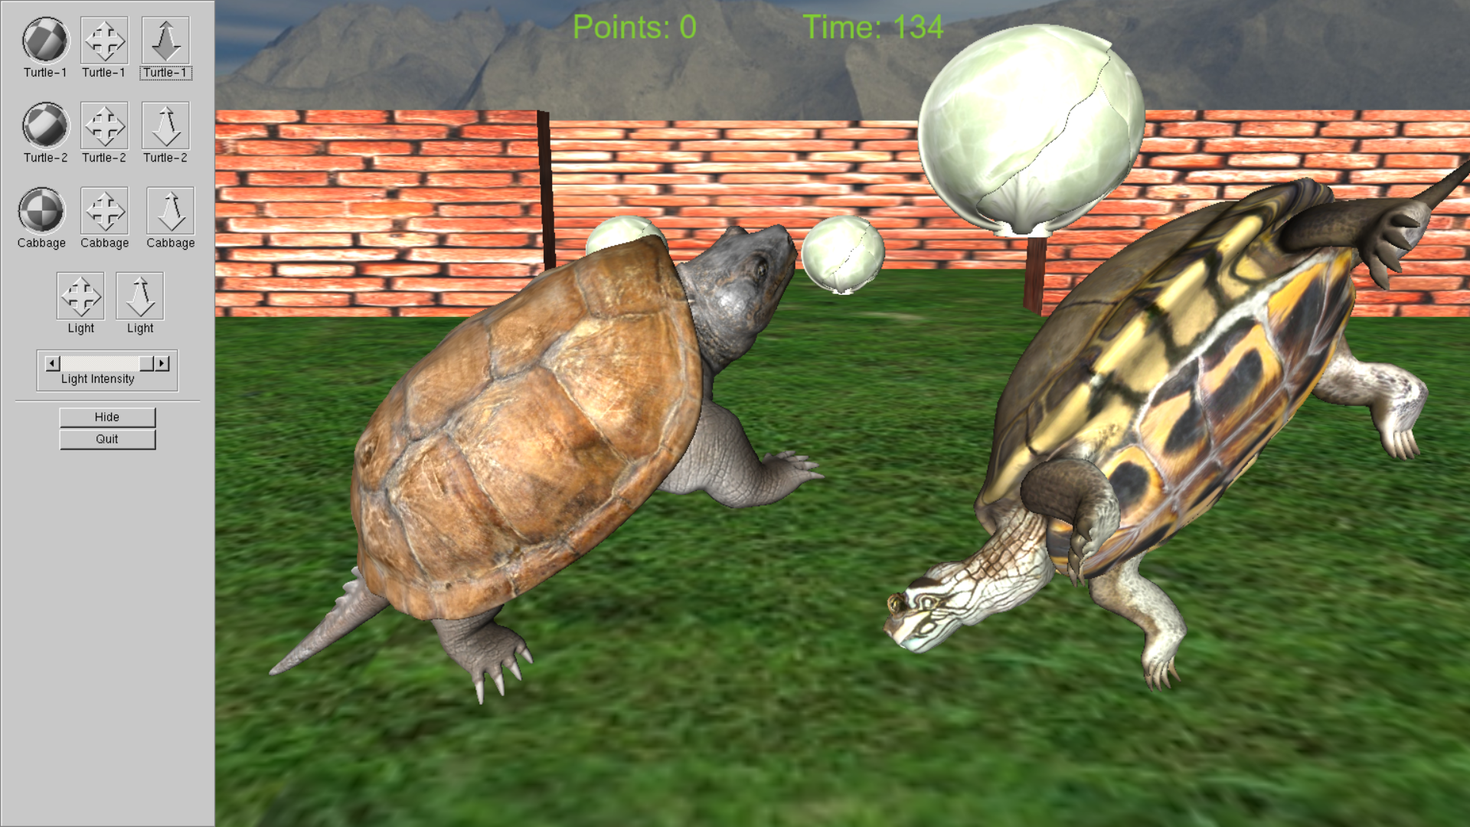

Slide 11
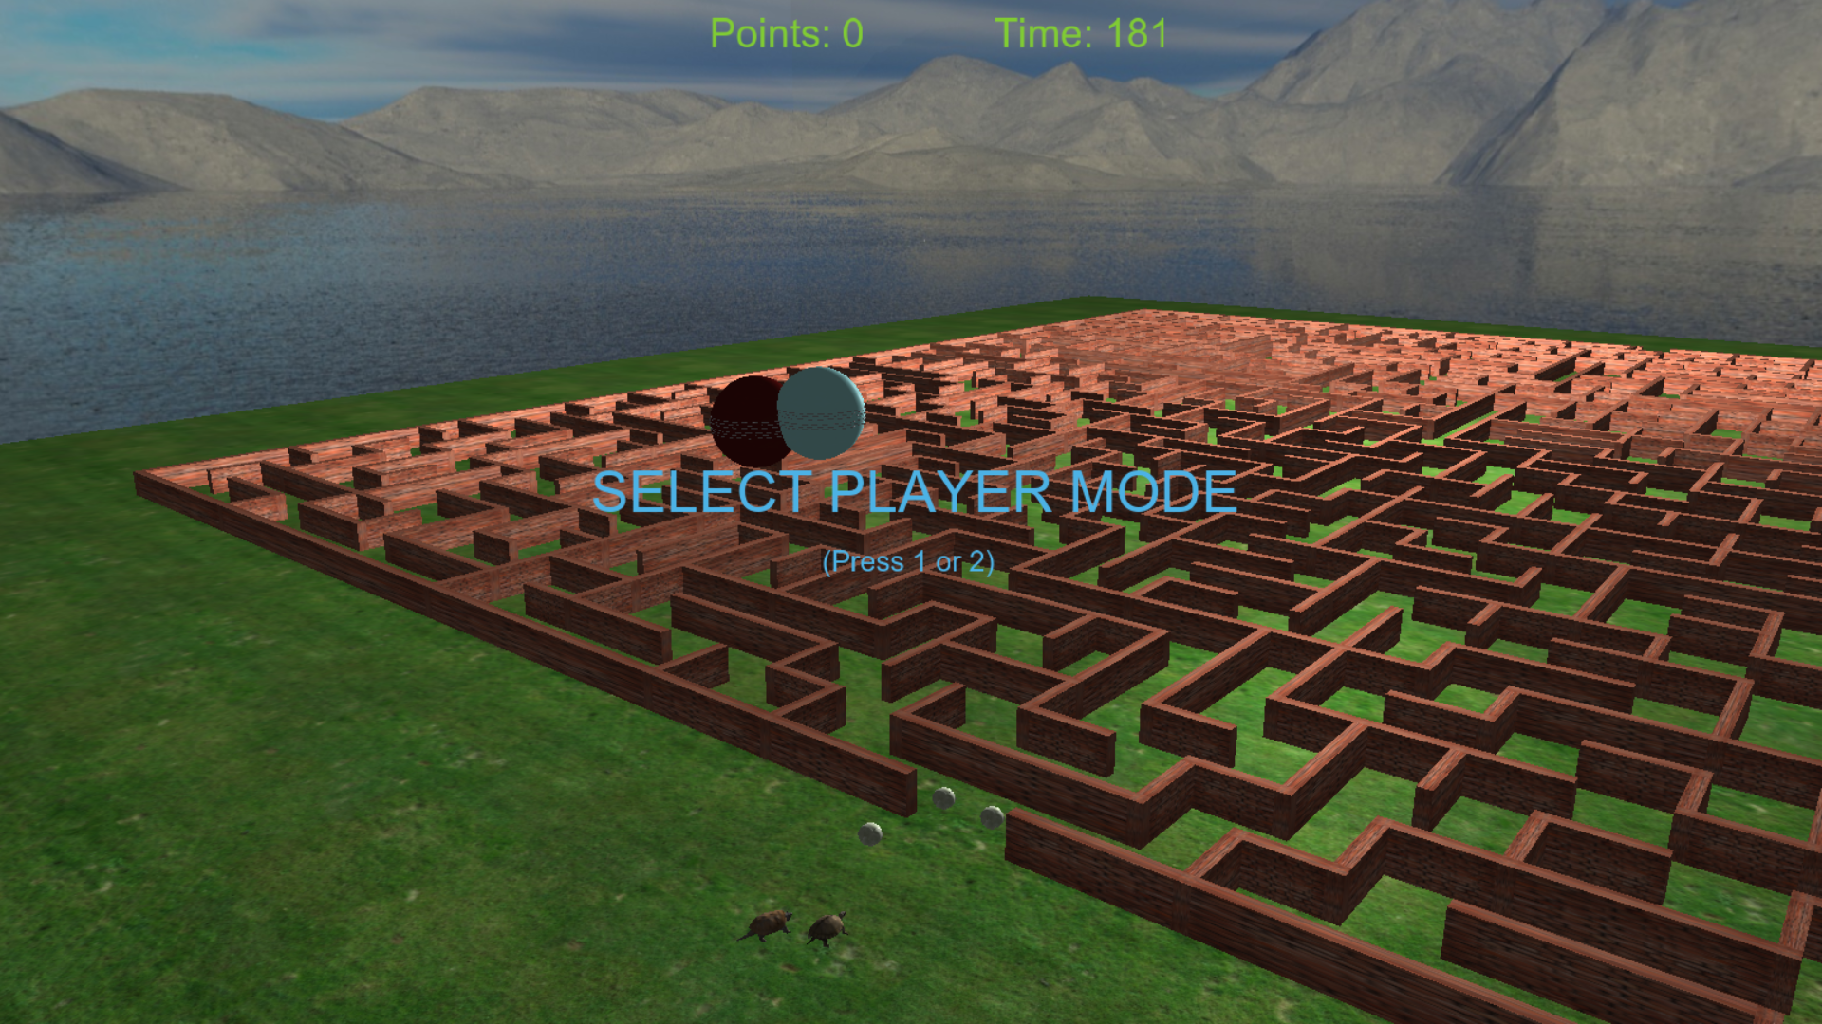

Slide 12
Collısıon detectıon
We implemented collectible cabbages with a simple col. det. algorithm.
Simply it draws a imaginary box around the cabbage and if position of the turtle is inside this box it triggers a collision event.

Slide 13
Nostalgıa shadıng
This shading is de/activated using «T» key (cube map and texts are not rendered with this shader)
It has been achieved by applying a color coefficient multiplication on top of all other light and texture calculations in fragment shader.

Slide 14
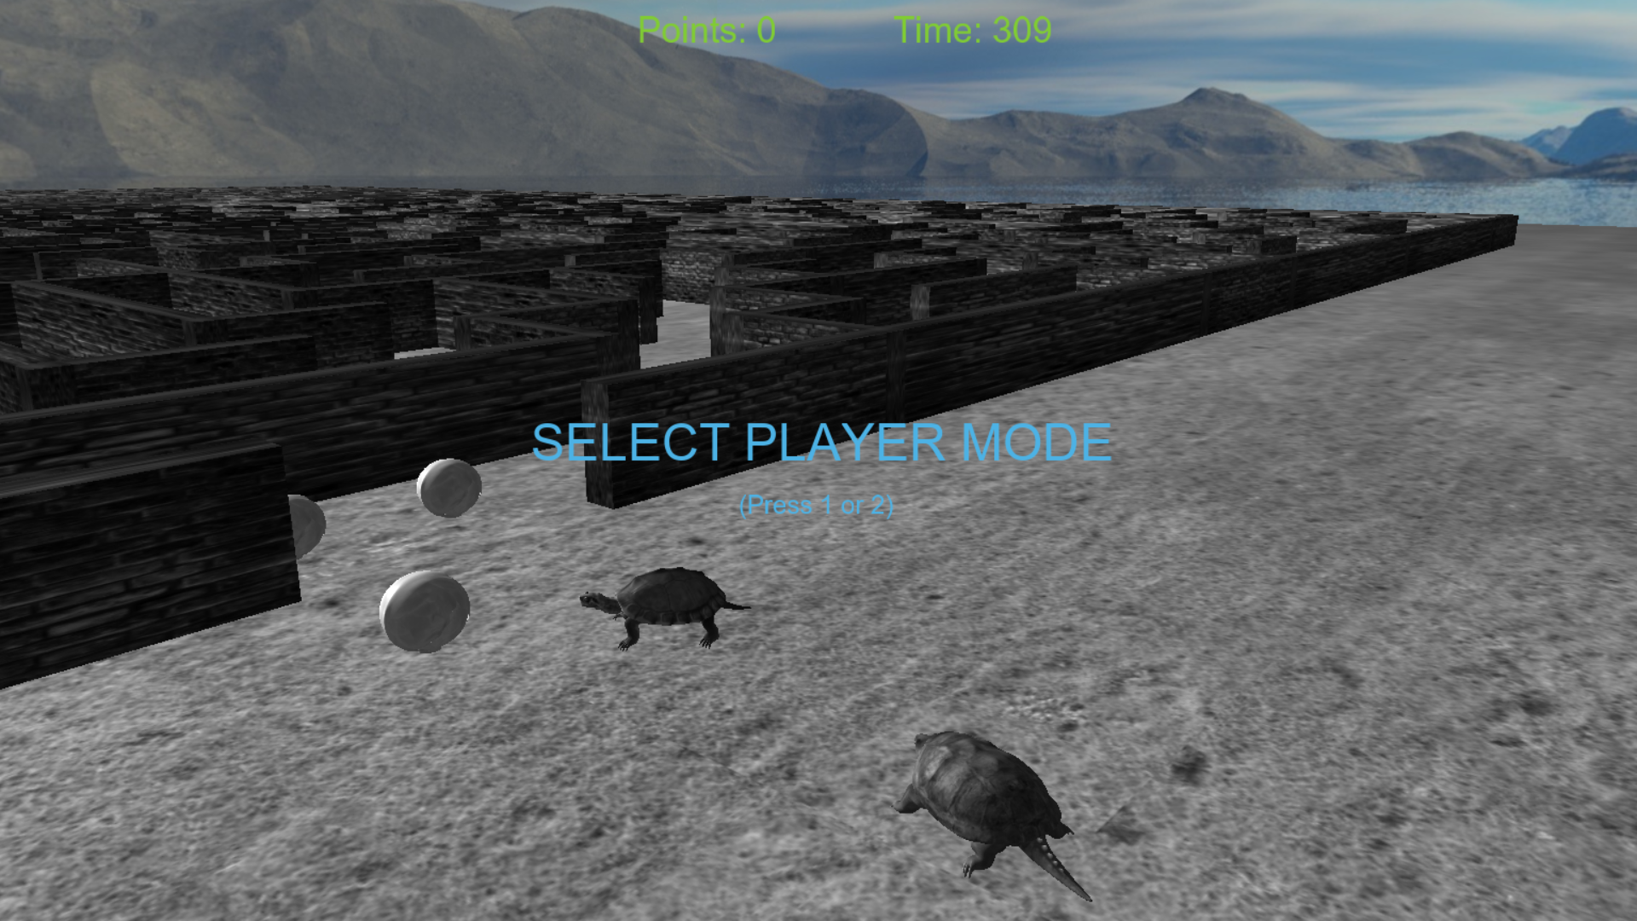

Slide 15
Text renderıng
We used FreeType to render the in game texts. It is a free open-source library.
Simply texts are bitmap textures of charecters rendered on their smallest transparent bounding square.
Texts have different perspective matricies and shaders.

Slide 16
Skybox
Skybox is basically a huge cubemap inside the world.
When you load and render six textures over this huge cube it gives an effect of a beautiful sky.

Slide 17
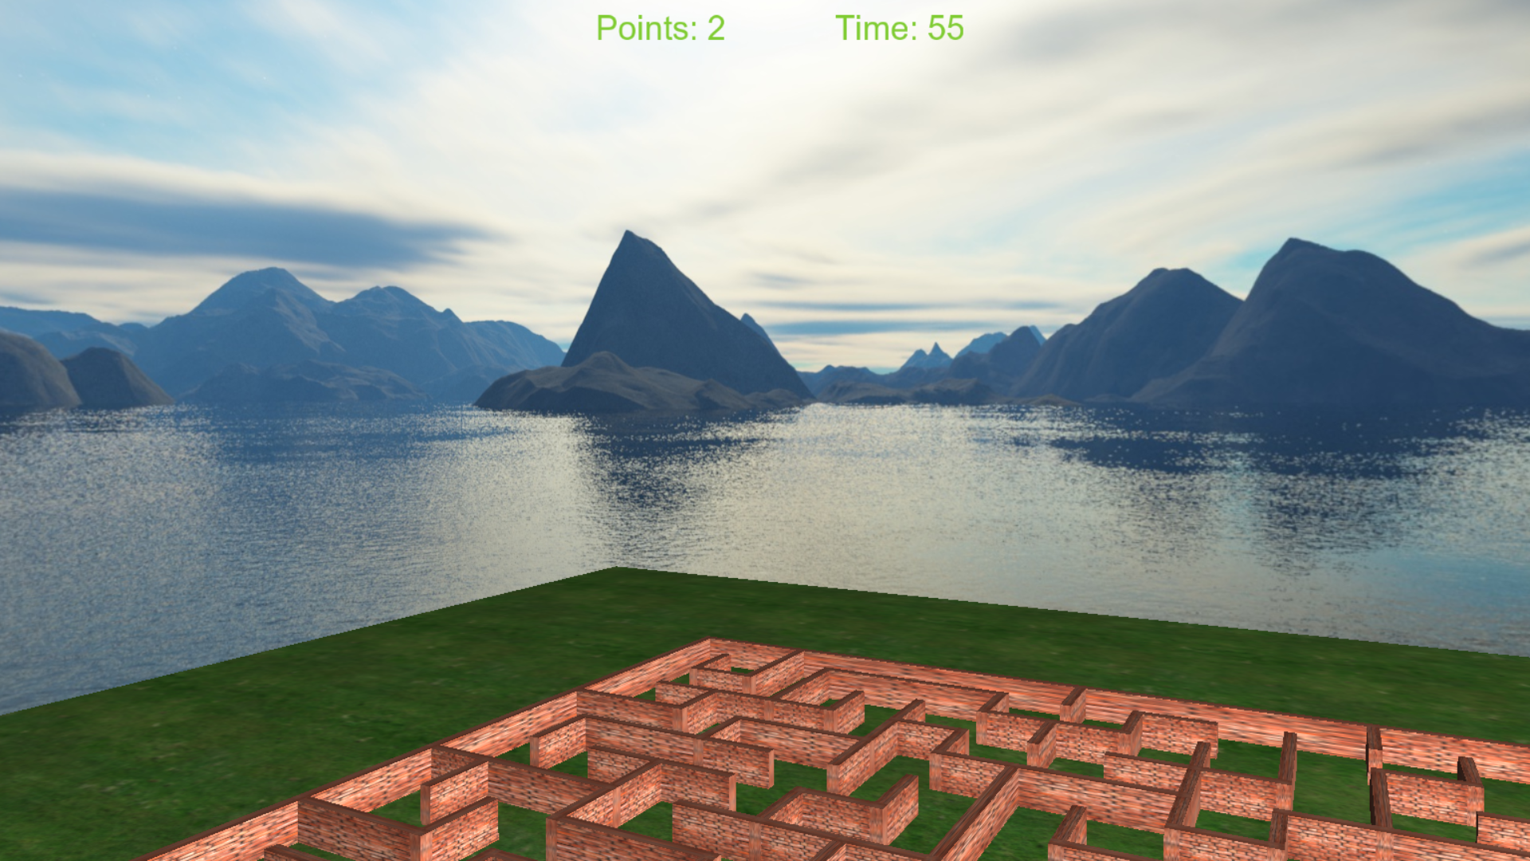

Slide 18
Thanks for lıstenıng…

